Slide 1
HPE CPP
Week 1 Learnings

Slide 2

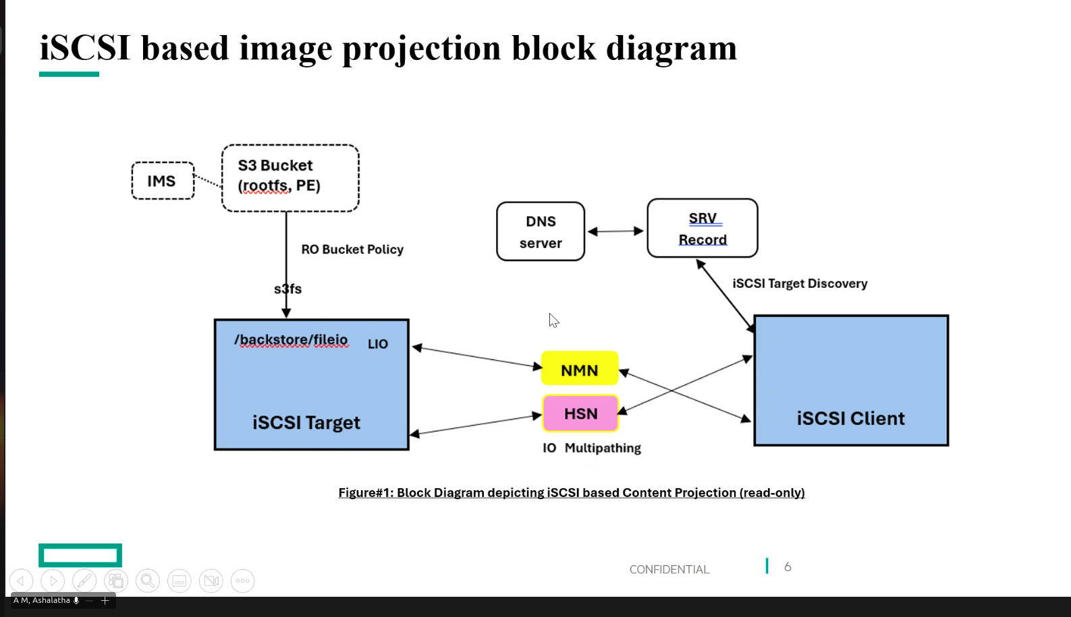
Last Meet

Slide 3

Contents
01
SCSI & LUN
02
Types of Boot
03
File Systems & PE Images
04
Kubernetes
05
Areas to Explore

Slide 4
01- SCSI & LUN

Slide 5
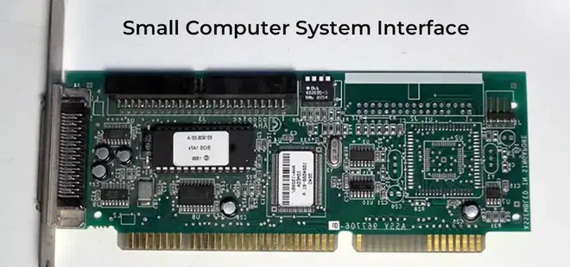
01 - SCSI (Small Computer System Interface)
SCSI is a command protocol for block devices.
The SCSI layer standardizes disk commands inside the OS. Storage drivers implement those commands over their specific transport.
It defines commands like:
- READ
- WRITE
- INQUIRY
- TEST UNIT READY
In SCSI architecture,
a target can expose multiple logical units.
Each logical unit is identified by a number.
That number is the Logical Unit Number LUN.
A LUN is an address inside a SCSI target.

Slide 6
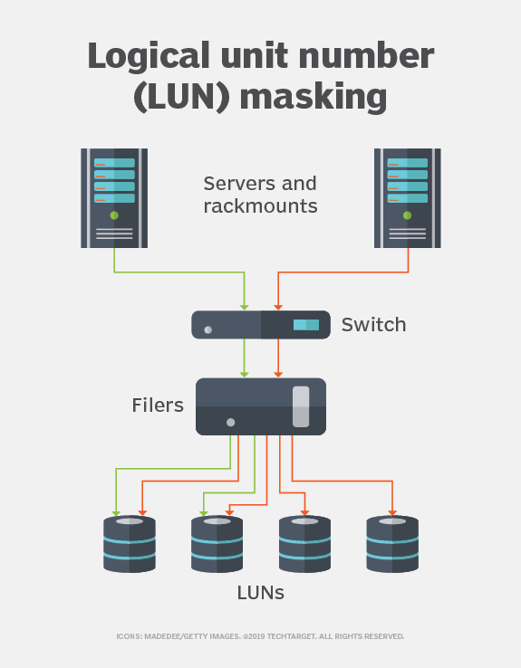
LUN ( Logical Unit Number)
A LUN is an address inside a SCSI target.
- Not a disk.
- Not storage itself.
- An identifier.
Imagine an iSCSI target server and has physical disk.
It carves this storage into logical units
Target:
iqn.2026-02.com.company:storage
LUN 0 → 100GB
LUN 1 → 50GB
LUN 2 → 200GB
Each LUN behaves like an independent disk.
The initiator logs in and sees:
/dev/sda
/dev/sdb
/dev/sdc
But those correspond to LUN 0, 1, 2.
That mapping happens at the SCSI layer.

Slide 7
LUN ( Logical Unit Number) Contd.
1. LUN ≠ Partition
A LUN is like an entire disk.
2. LUN ≠ Physical Disk
One disk can host multiple LUNs.
Multiple disks can back one LUN.
LUN is abstraction.
3. LUN Addressing
In simple systems:
LUN = small integer (0, 1, 2…)
In enterprise SCSI:
LUNs are 64-bit values.
They can encode complex addressing.
Because LUN is block-level the client OS thinks it owns the disk.

Slide 8
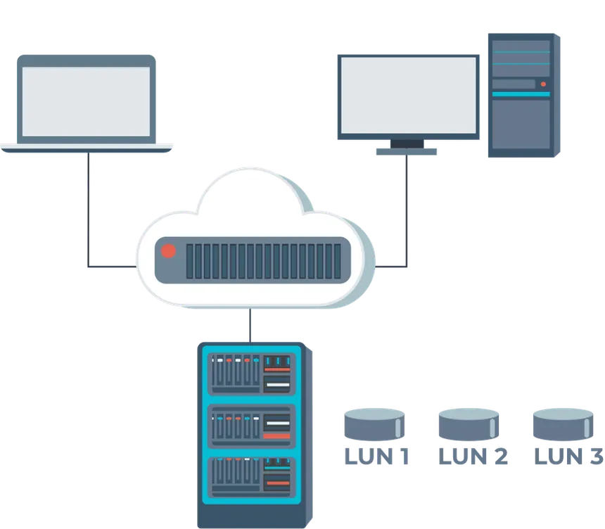
LUN ( Logical Unit Number) Contd.
Provisioning Types
- Thin provisioning:
LUN claims to be 100GB.
Actually only consumes storage as data is written.
- Thick provisioning:
Full space reserved upfront.
Thin provisioning saves space.
Backstore:
The backstore defines where the actual data lives.
LUN is created from a backstore.
The LUN does not contain data.The backstore does.
The LUN is just a pointer to a backstore.
Several types of backstore: fileio, block, memory-backend, pscsi
In LIO(Linux I/O), steps are conceptually:
1. Create backstore
2. Create target (IQN)
3. Create LUN mapping
4. Allow initiator access

Slide 9
SBPS ( Scalable Boot Content Projection)
In SBPS (Scalable Boot Content Projection):
Each node may receive:
- Its own LUN
OR
- A shared read-only LUN
That LUN contains rootfs.
Boot Flow:
1. S3
2. s3fs
3. Backstore
4. LUN
5. ISCSI Target
Client side
6. PXE
7. DHCP + TFTP
8. Kernel + iSCSI Login
9. LUN appears as /dev/sdx
10. Mount rootfs
11. boots

Slide 10
02- Types of Boot

Slide 11
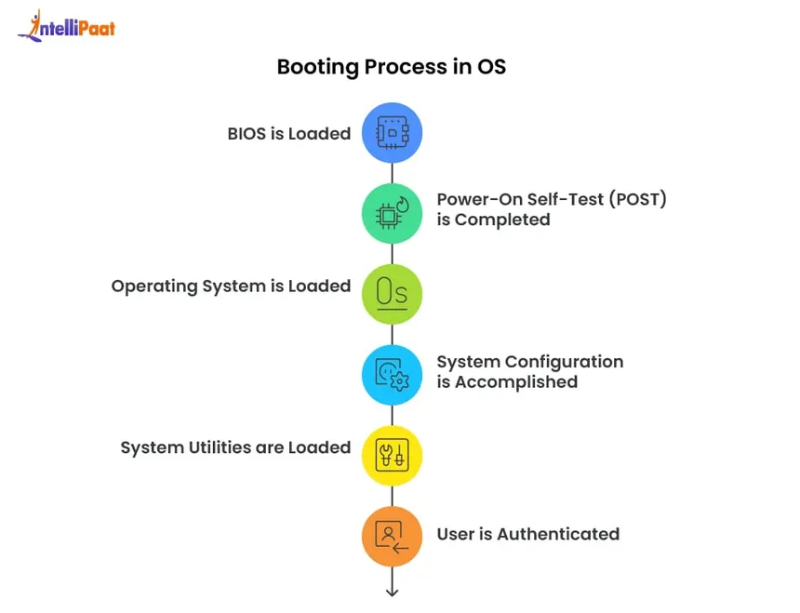
What is Boot ?
Booting is the process of loading an operating system into memory and transferring control to it.
Minimal abstract sequence:
1. Firmware runs (BIOS or UEFI)
2. Bootloader loads kernel
3. Kernel initializes hardware
4. Kernel mounts root filesystem
5. init system starts services
Every type of boot changes where steps 2 and 4 get their data from.

Slide 12
Local Boot
Boot Procedure:
1. Firmware
2. Bootloader (from local disk)
3. Kernel (from local disk)
4. rootfs (local disk)
Everything comes from a locally attached storage device.
No network dependency.
Simple and Fast.
Not scalable for data centers.

Slide 13
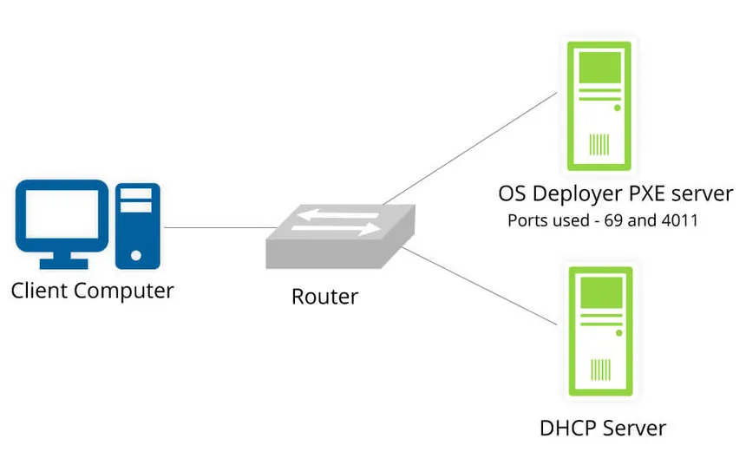
Network Boot
The OS or bootloader is loaded over the network instead of local storage.
It’s a category, not a specific protocol.
Examples:
- PXE boot
- iSCSI firmware boot
Network boot modifies the early stages of boot.
Instead of reading disk sectors locally, firmware contacts a server.

Slide 14
PXE Boot (Preboot Execution Environment)
PXE is the most common implementation of network boot.
It operates at firmware level.
Flow:
1. Machine powers on.
2. BIOS/UEFI checks boot order.
3. PXE option is selected.
4. NIC firmware broadcasts DHCP request.
5. DHCP server responds with:
- IP address
- TFTP server location
- Boot file name
6. Client downloads bootloader via TFTP.
7. Bootloader loads kernel + initramfs.
8. Control transfers to Linux kernel.
PXE only gets you to the kernel stage.
It does not provide persistent storage.
After kernel loads, you still need a root filesystem.
That’s where NFS or iSCSI enters.

Slide 15
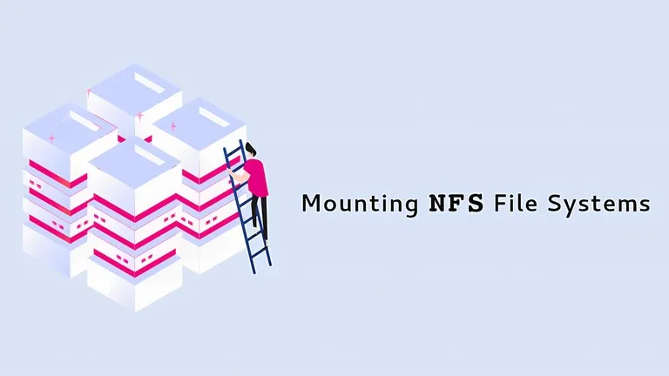
NFS Boot (Network File System)
NFS boot is file-level network boot.
Flow:
1. Firmware
2. PXE
3. kernel + initramfs
Kernel mounts rootfs over NFS
Instead of block device, the root filesystem is accessed as a remote directory.
So root (/) is actually: nfs://server/rootfs
Advantages: Simple, Easy to share across many clients,
No per-node disk required
Disadvantages: File-level protocol, Network latency impacts, filesystem operations, Requires reliable network

Slide 16
ISCSI Boot (Block Level Network Boot)
Instead of mounting files via NFS,
the client mounts a block device via iSCSI.
Flow: Firmware → PXE → kernel + initramfs
- initramfs logs into iSCSI target
- LUN appears as /dev/sdX
- Kernel mounts /dev/sdX as root
Difference from NFS:
- NFS = remote files
- iSCSI = remote disk
OS thinks it owns a local disk.

Slide 17
03 – File Systems

Slide 18
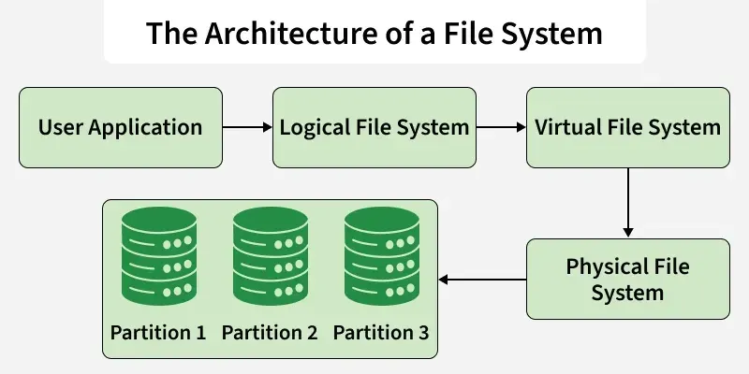
What is a File System ?
A filesystem is a data structure and set of rules that organizes bytes on a storage medium into files and directories.
A disk without a filesystem is just a block device - a sequence of numbered blocks.
The filesystem provides:
- Metadata (file owner info, permissions, timestamps)
- Directory structure
- Mapping from file → physical blocks
- Journaling or consistency mechanisms (optional)
Examples: ext4, xfs, btrfs, ntfs, fat32
Block device ≠ filesystem
Filesystem lives on a block device.
In iSCSI: LUN → appears as block device → you format it → filesystem exists inside it.

Slide 19
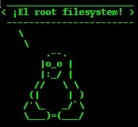
Rootfs ( Root File System )
rootfs is simply the filesystem mounted at /.
It contains: /bin, /lib, /etc, /usr, /var, /sbin, etc.
It is the operating system.
When we say “booting an OS”, we really mean:
1. Mount rootfs
2. Execute /sbin/init (or systemd)
3. Everything else is preparation.
During early boot:
- initramfs is temporary rootfs.
- Then kernel switches to real rootfs.
- Then init process starts.
So rootfs is not a special filesystem type.
It is a role.
Any filesystem can be rootfs:
- ext4 on local disk
- NFS mount
- iSCSI LUN

Slide 20
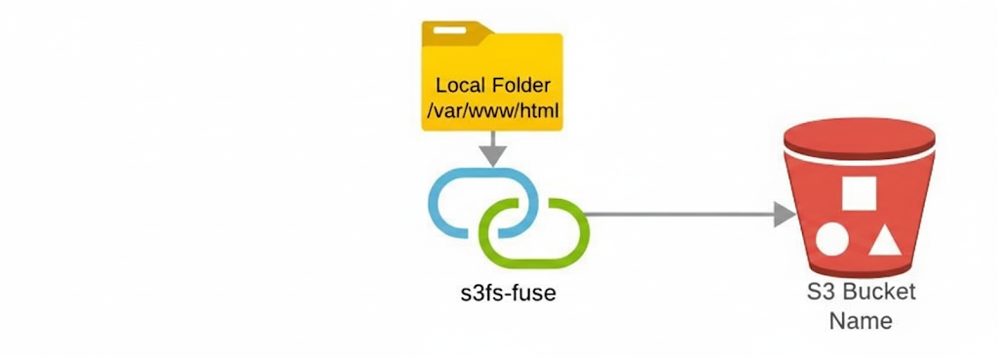
s3fs ( Simple Storage Service(S3) File System )
s3fs is a FUSE-based filesystem that mounts an S3 bucket as a local filesystem. It does NOT provide block storage.
It provides object storage mapped to file semantics.
S3 is:
- Object storage.
- Not block.
- Not POSIX-native.
s3fs translates open(), read(), write() into S3 API calls.
Limitations:
- High latency
- Not truly POSIX compliant
- No real in-place modification (objects rewritten)
-Performance depends heavily on caching
s3fs is good for:
- Static assets
- Logs
- Backup access
It is bad for:
- Databases
- Root filesystem
- High IOPS workloads

Slide 21
04 – Kubernetes

Slide 22
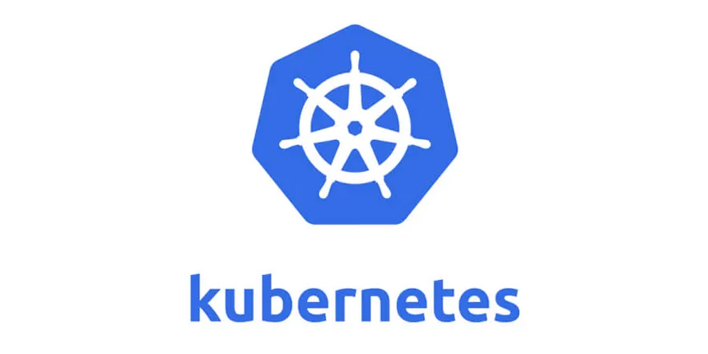
Kubernetes
Kubernetes is a container orchestration platform. It automates deployment, scaling, networking, and lifecycle management of containerized applications.
It was created at Google and open-sourced in 2014. It’s now governed by the Cloud Native Computing Foundation (CNCF).
Containers are just isolated processes.
Docker made packaging easy.
But once you want to run 50 containers across 10 machines with failover, scaling, rolling updates, service discovery, health checks, and networking - manual management collapses.
Kubernetes solves that coordination problem.

Slide 23
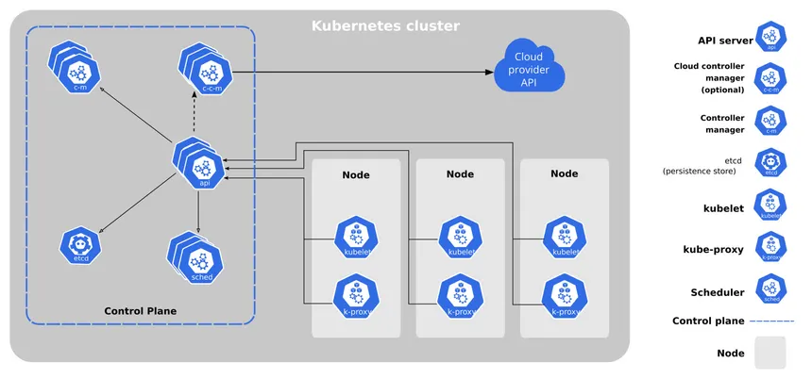
Kubernetes Architecture

Slide 24
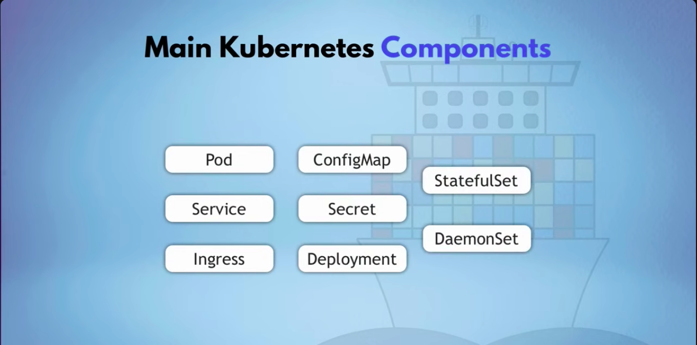
Kubernetes Components

Slide 25
05 – Areas to Explore

Slide 26
Areas to Explore
1. LIO Implementation
2. Backstore & s3fs Implementation
3. S3 Bucket Integration
4. PXE + DHCP Setup
5. iSCSI Client & Target Setup
6. initramfs & iSCSI Root Boot Configuration
7. OS Image Creation & Versioning Strategy
8. Metadata & State Management Design
9. Failure Handling & Recovery Scenarios
10. Observability & Debugging Workflow

Slide 27
Thank you!

